Slide 1
SpaceX Falcon9 landing Prediction
By Eshan Wickramarachchi

Slide 2
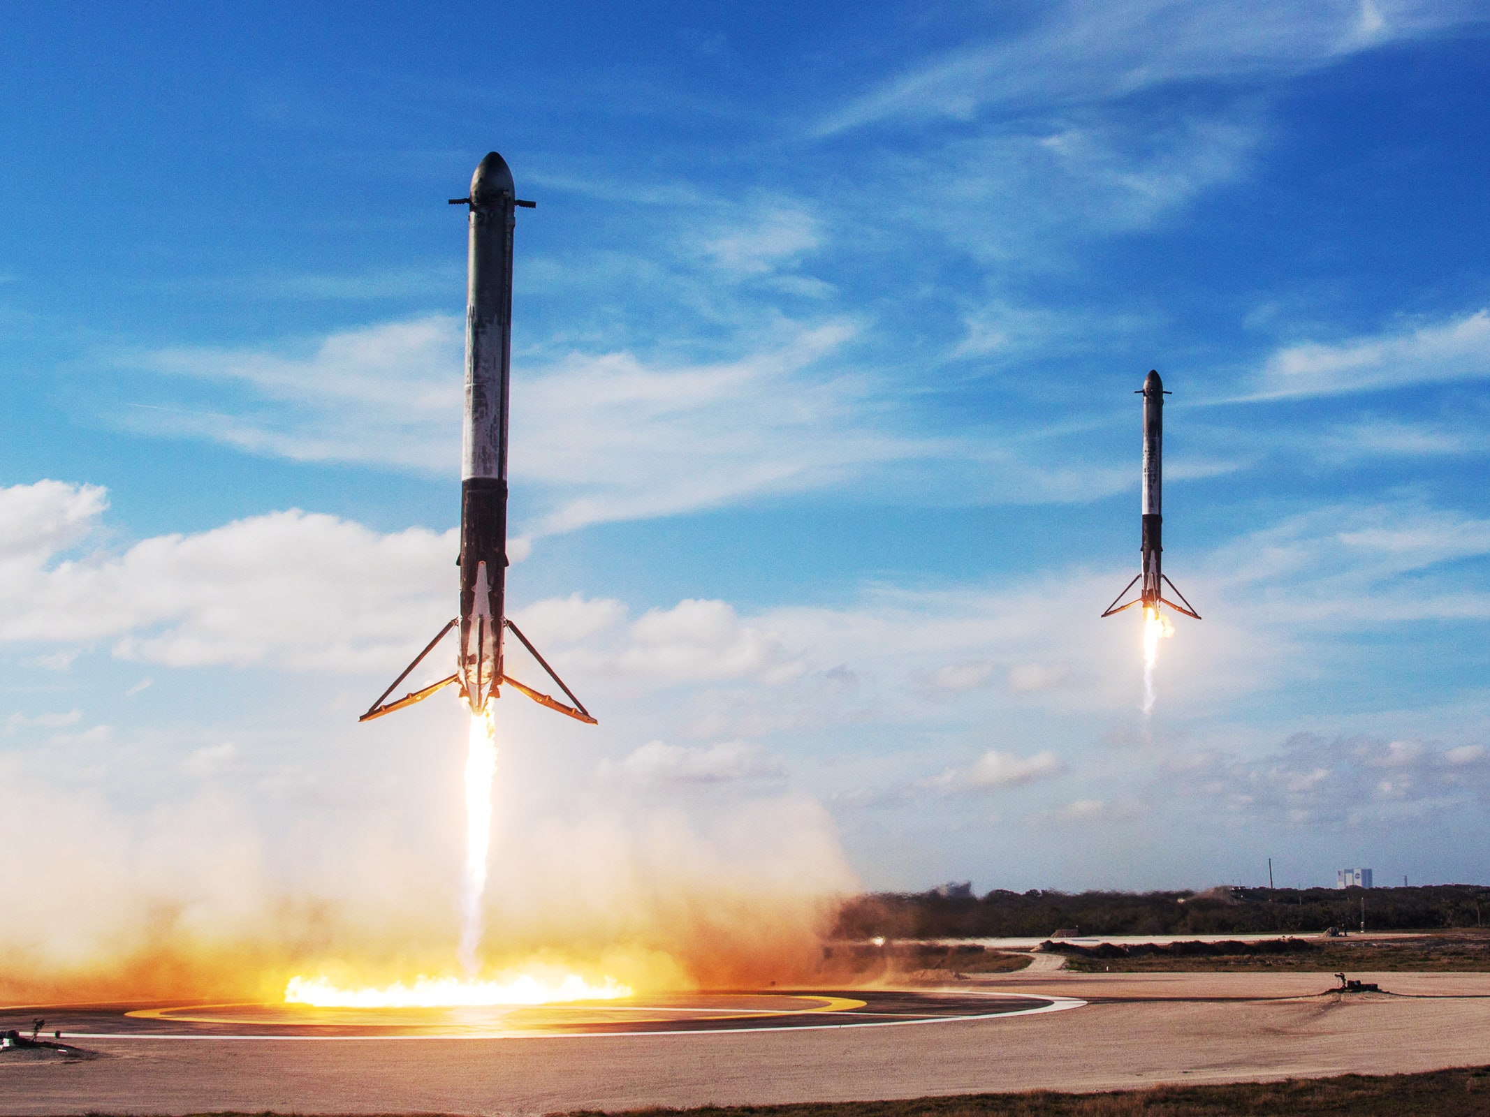
Falcon 9
SpaceX Faclon9 - 62 Million dollars per launch
Competition - 165 Million dollars + per launch

Slide 3

Data Collection and Preparation
Data Sources: Data collected from SpaceX API and additional public data using web scraping (e.g., payload weight, flight number, launch site).
Data Wrangling: Cleaned data to handle missing values, removed irrelevant variables, and performed one-hot encoding for categorical variables like orbit type.

Slide 4
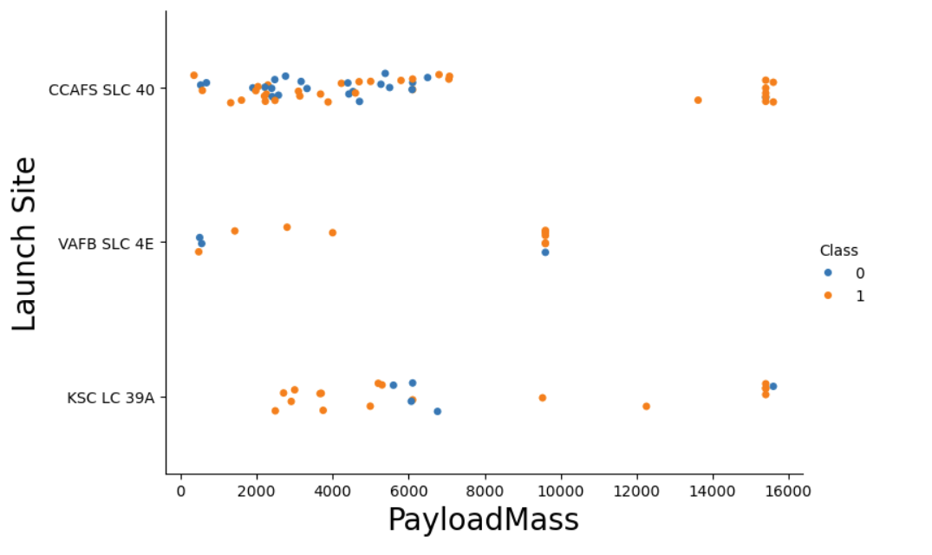
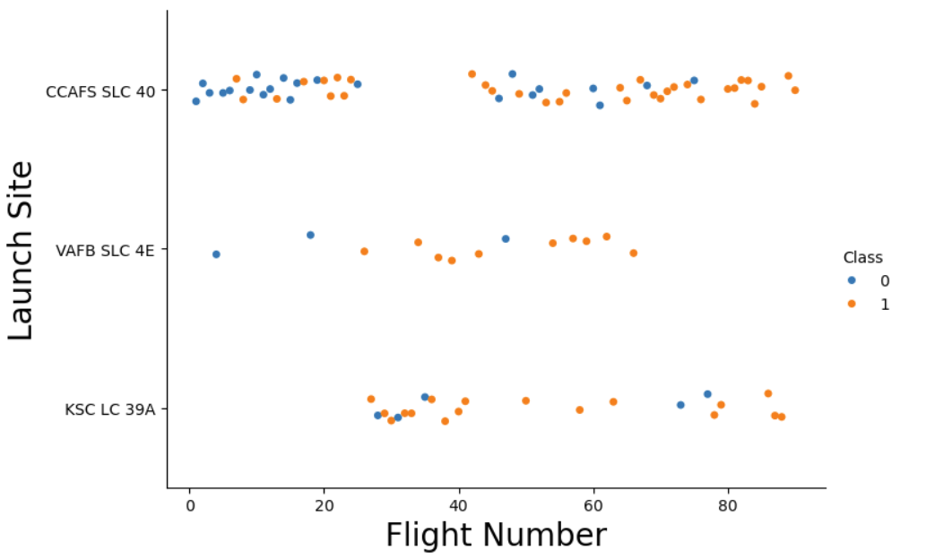
Launch Site
100% success rate with Payload > 6500kg
Last 5 launches ALL successful
100% success rate with Payload < 5550kg

Slide 5
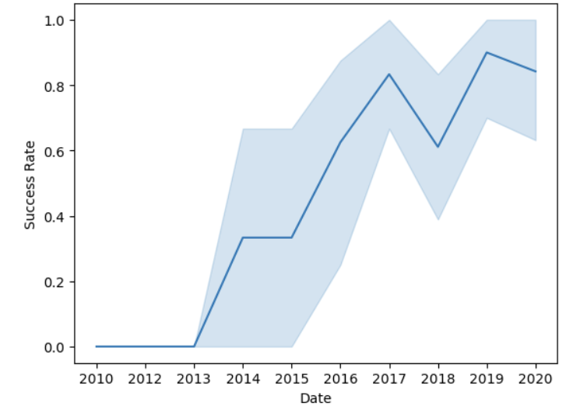
Launch Success Yearly Trend
Overall Positive correlation between date and success rate
Dip in 2018 due to changes in model
Stagnation around 80% success rate

Slide 6
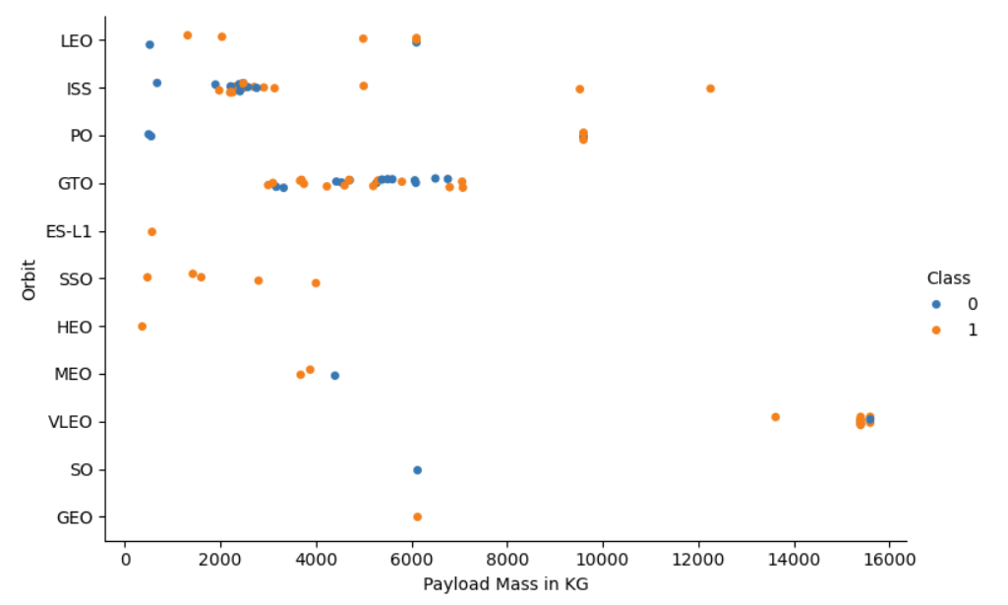
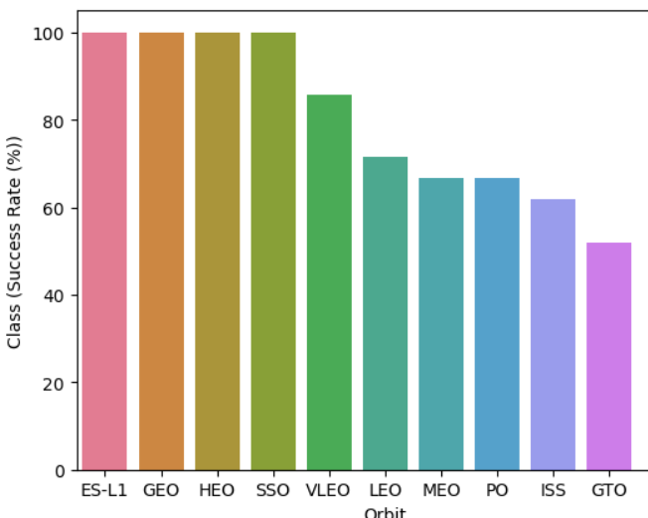
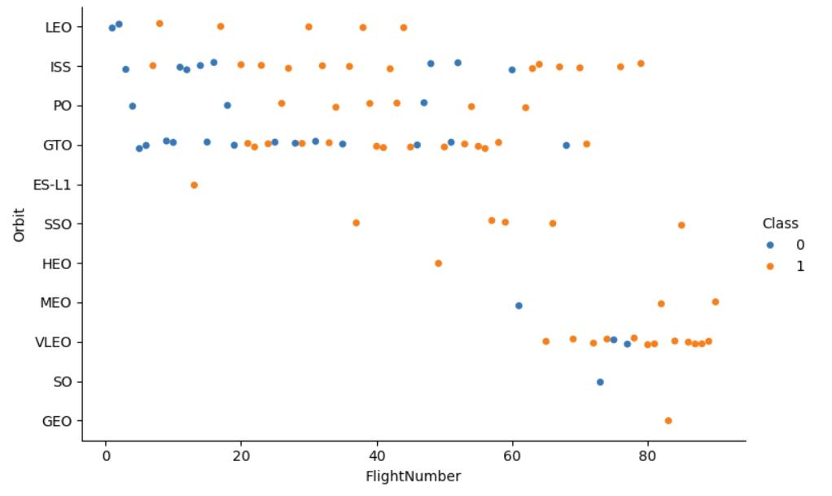
Orbit Type
ES-L1, GEO & HEO all only have one launch

Slide 7
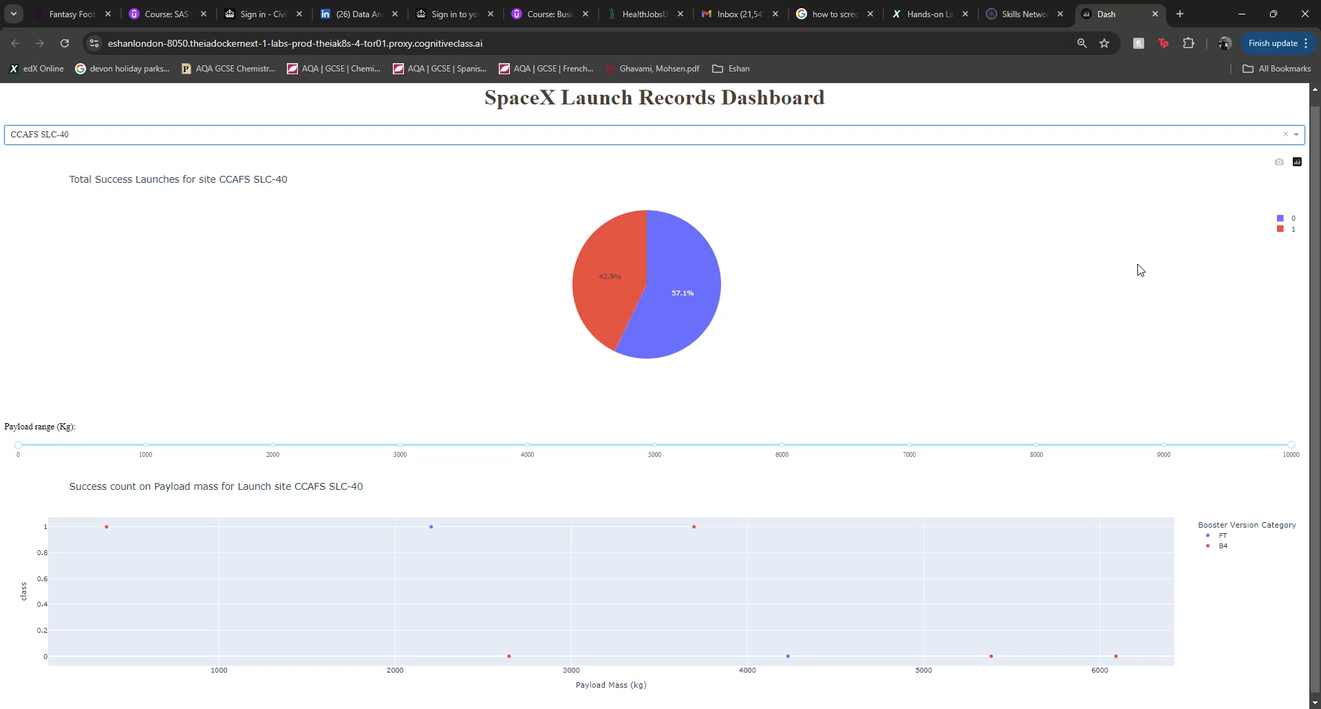
Dashboard

Slide 8
Predictive Model
Building Model
Convert data we have gathered for model use
Evaluating Model
Use GridsearchCV for hyperparameters optimisation
Check the accuracy for each model on the test data
Improving Model
Use Feature engineering and choosing the best hyperparameters for each model
Finding Best Model
Use the function train_test_split to split the data into training and test data
Chose appropriate Machine Learning algorithms for the project.
Get tuned hyperparameters for each type of algorithms.
Make a table with all the model accuracies of the refined models and the one with the highest accuracies the best model

Slide 9
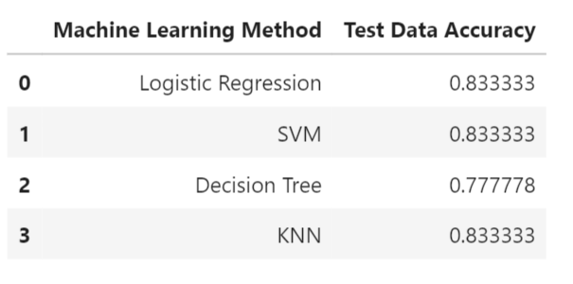
As you can see from the table, 3 models had the joint highest accuracy on the test data so model choice is up to the user.
Model Accuracy

Slide 10
Conclusions
Different Launch sites have different chances of success, but all launch sites are more likely to succeed than fail with the lowest launch site success rate being above 50% and the highest being 77%.
When looking overall at the data , one of the strongest trend is the increase in success rate with flight number meaning the success rate has increased with time with each launch as show by the Yearly Launch Success graph with there being an 80% chance of a successful landing for future launches.
Orbit Types are seen to have an effect, but further data is required to make a complete conclusion on some orbits. However, conclusions can be made on certain orbits that have more data such as SSO with 100% success rate and ISS also with a 100% success rate with payload over 3500KG.
This means that to predict the landing outcome successfully many factors such as the mission's payload, orbit type and launch site will have to be taken under consideration to make an accurate prediction but if all these details are provided pre-launch, then we can predict the mission out come to an 83% accuracy through the predictive model.

Slide 11
Limitations and Next Steps
Limitations
The model currently relies on available historical data. External factors, such as regulatory changes or new technology, could impact future predictions.
Next Steps
Continuous model refinement with the updated data and additional factors specified would improve accuracy and provide even more detailed insights for investors.
Add predictive model to dashboard

Slide 12


Slide 13
Appendix
Code

Slide 14
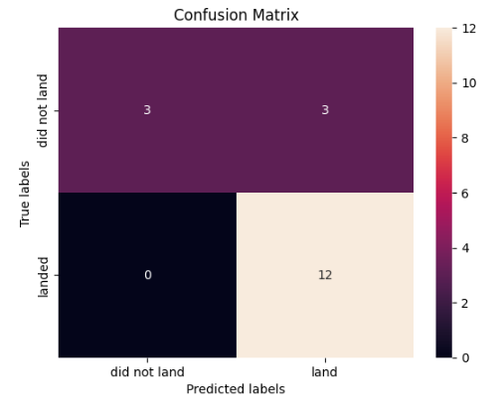
Confusion Matrix
The main area for concern would be the 3 false positives

Slide 15
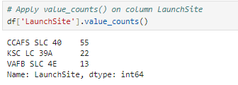
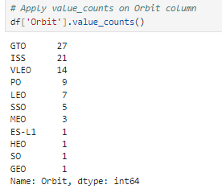
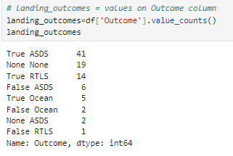
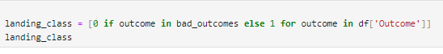
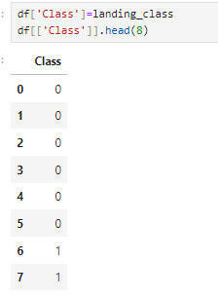
Data Wrangling
Calculate the number of launches on each site
Calculate the number and occurrence of each orbit
Calculate the number and occurence of mission outcome per orbit type
Create a landing outcome label from Outcome column

